Slide 1
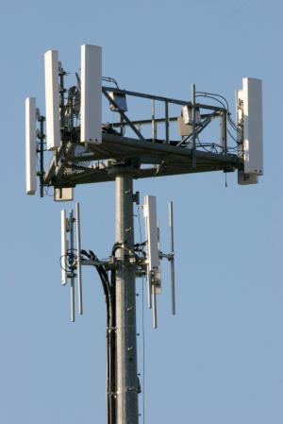
Wavecon 5G Launch Impact Analysis
Prepared by Vishal Agarwal

Slide 2
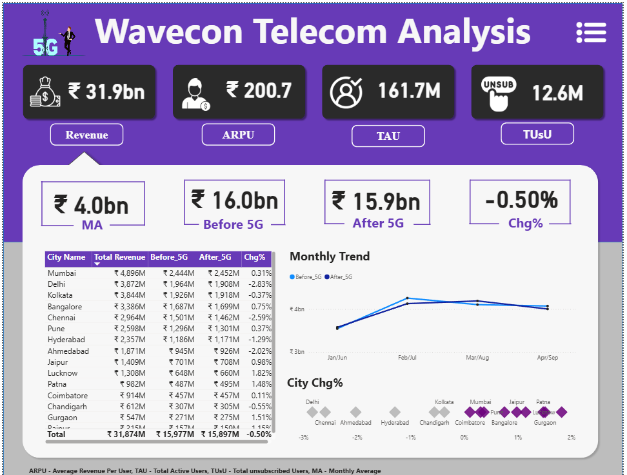
Dashboard View

Slide 3
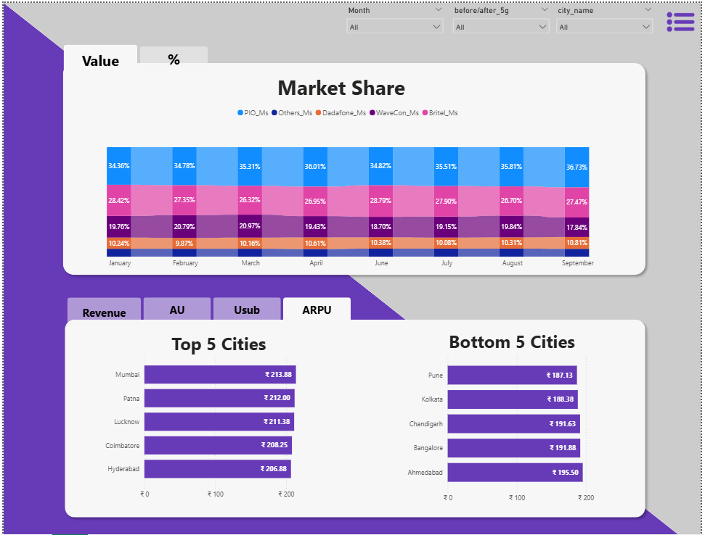
Market View

Slide 4
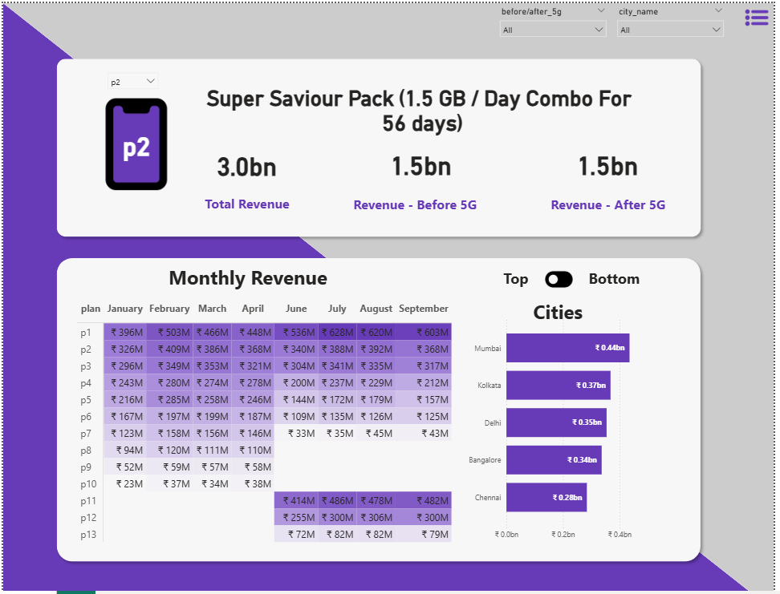
Plan View

Slide 5


Q1: 5G Impact on Revenue
Revenue Trend Analysis Pre vs. Post-5G
Line chart comparison shows steady revenue trajectory; no significant upward or downward shift observed post-5G launch.
Key Finding: Minimal Revenue Impact
5G launch has resulted in minimal impact on Wavecon's overall revenue performance, maintaining consistent growth patterns.

Slide 6
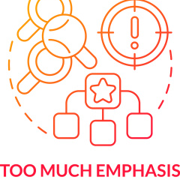

Q2: Underperforming KPI Post-5G
Identified Underperforming KPI: Total Active Users (TAU)
Total Active Users (TAU) emerged as the underperforming KPI, showing a clear downward trend post-5G implementation.
TAU Decline: Key Growth Driver Concern
TAU, a critical growth driver for Wavecon, is experiencing negative momentum, raising concerns for user base expansion.

Slide 7

Q3: Plan Revenue Performance
Top-Performing Plan: Plan 1
Plan 1 leads with ₹603M revenue (last month), outperforming all other plans significantly in the post-5G period.
Low-Performing Plan: Plan 7
Plan 7 underperforms with only ₹43M revenue (last month), showing minimal contribution to overall plan revenue.

Slide 8
Q4: Significantly Impacted Plan (Plan 7)
01
Plan 7 Performance Post-5G: Severe Impact
Plan 7 is severely impacted post-5G, generating only ₹43M revenue with a sharp downward trend in performance.
02
Recommendation: Discontinue Plan 7
Non-viable revenue contribution and sustained downward trajectory warrant discontinuation of Plan 7 to optimize resource allocation.

Slide 9

Q5: Discontinued Plans & Reasons
Discontinued Plans: 8, 9, 10
Rationale for Discontinuation
Plans 8, 9, and 10 have been discontinued post-5G launch following performance evaluation and viability checks.
Discontinuation driven by insignificant revenue generation, making these plans no longer viable to maintain operationally.

Slide 10

Key Takeaways
Minimal 5G Impact on Overall Revenue
5G launch has had minimal impact on Wavecon's total revenue, maintaining steady performance trends.
TAU Decline: Critical KPI Concern
Total Active Users (TAU) is underperforming with a downward trend, raising concerns for user base growth.
Plan Performance: Highs and Lows
Plan 1 (₹603M) leads as top performer; Plan 7 (₹43M) is the weakest with minimal contribution.

Slide 11


Recommendations & Next Steps
Recommendations: Strategic Focus Areas
Strengthen customer adoption strategies, prioritize high-performing plans, and discontinue/restructure underperforming ones.
Next Steps: Actionable Initiatives
Enhance 5G adoption through customer engagement, reallocate resources to profitable plans, and implement close KPI monitoring.

Slide 12

Q&A | Thank You
Open Floor for Questions
Engage in interactive Q&A to address queries and insights on 5G performance, KPIs, and strategic plans.
Thank You & Wavecon Commitment
Thank you for your time. Wavecon: "Connecting Tomorrow, Today" – Let’s drive 5G success together!

Slide 13
THE END

